Slide 1
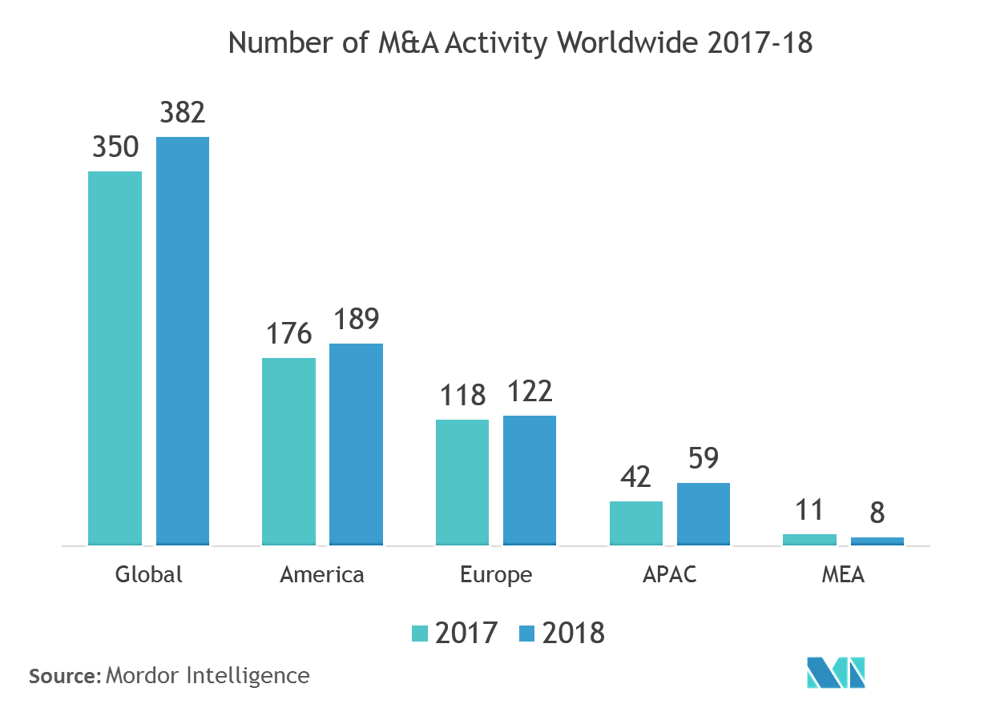

DATA SCIENCE PROJECT
PREDICTING INSURANCE COST

Slide 2



Item 5
20%
Item 1
20%
Item 4
20%
Item 2
20%
DATASET INFORMATION
Item 3
20%
This is a real data set and is collected from kaggle.
The data contains 1338 rows and 7 columns
The Variables & attributes( Qualitative& Competitive) of the data set includes
age ,sex, BMI, children, Smoker. Region and charges.
The name of data set is "medical cost personal datasets"
In this data set there are 6
independent and 1 dependent variable.

Slide 3

Reason for choosing the data set
To analyse depending factors
To predict the insurance cost
To analyse the major factor on which insurance cost depends.
To analyse the future of insurance cost and the factors affecting it.

Slide 4

Descriptive Analytics on Data

Slide 5

Importing Libraries
Importing Libraries
Importing the libraries that will be used throughout the programming

Slide 6
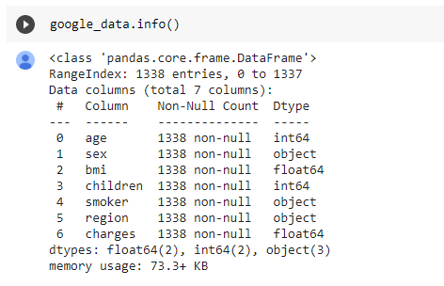

Null or missing values
In order to check whether there is any null or missing values in our data set
There is no missing or null value in our data set

Slide 7
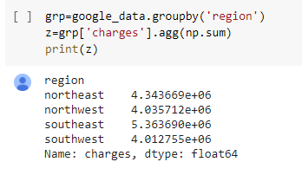
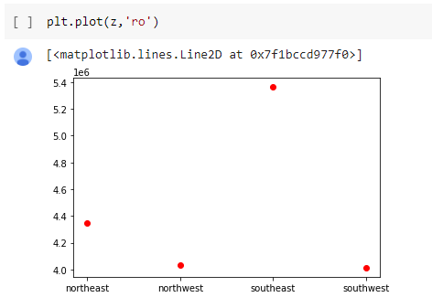
Relationship between region and charges
To understand the region having the highest insurance charges.
South east region spends the most on the insurance charges as compared to other regions.

Slide 8
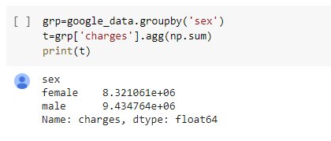
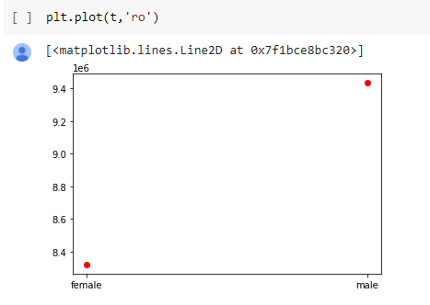
Relationship between gender and charges
To understand the gender which spends more on insurance charges
We found that male spends more on insurance charges than females.

Slide 9
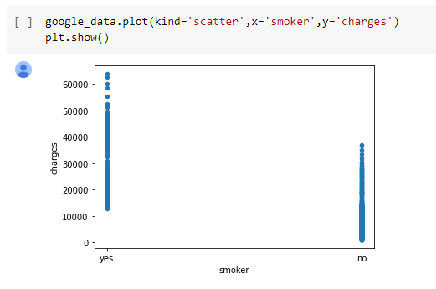
Relationship between smoking and charges
To understand the spending pattern of smokers and non smokers
We found that people who smoke spends more on insurance charges than non smokers and the spending of smokers is between 10,000 to 65,000 while spending of non-smokers is between 1,000 to 40,000.

Slide 10
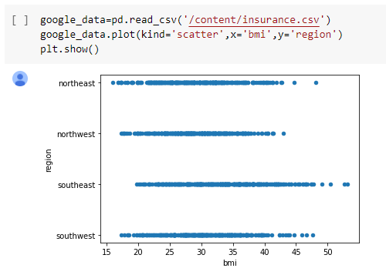
Relationship between BMI and region.
To understand the relationship between region and BMI.
We observed that BMI index of people of south east region is more than BMI index of people of other regions.

Slide 11
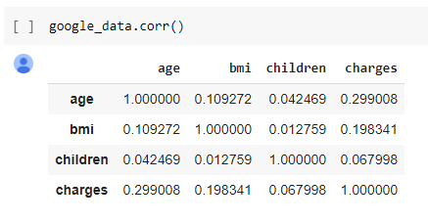
Correlation
We see that the data is positively correlated with every parameters but there is no strong correlation.

Slide 12

ML ALGORITHM

Slide 13
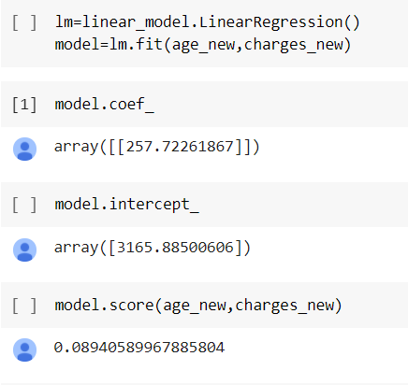
If we check model based on age, the model is only 8.9% accurate. So only age factor cannot be considered for charges.
Model based on age

Slide 14
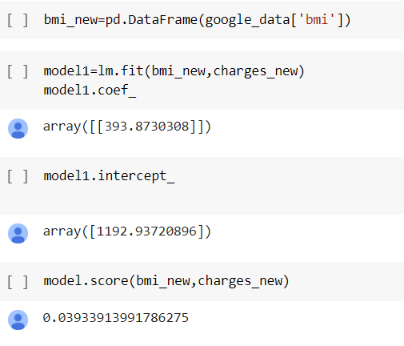
We tested another model using BMI as a factor, but after testing we found that the model is only 3.9% accurate
Model for Charges based on BMI

Slide 15
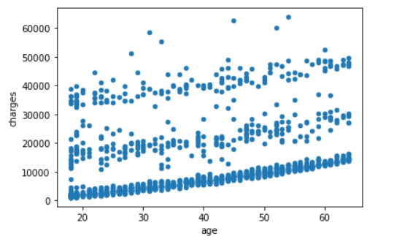
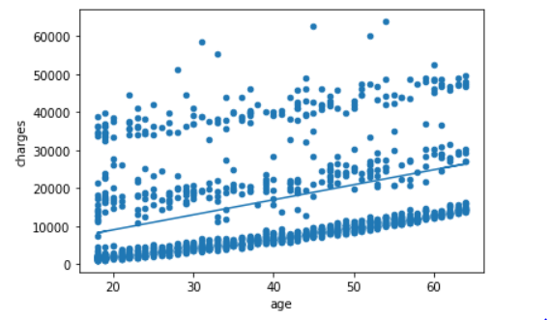
Scatter diagram is plotted for charges with respect to age. Distribution shows a progressive trend, we cannot conclude that charges are only depended on age.
Charges distribution on basis of Age
We have predicted charges on basis of age, we can observe a linear line but there are many outliers
Charges distribution on basis of Age

Slide 16
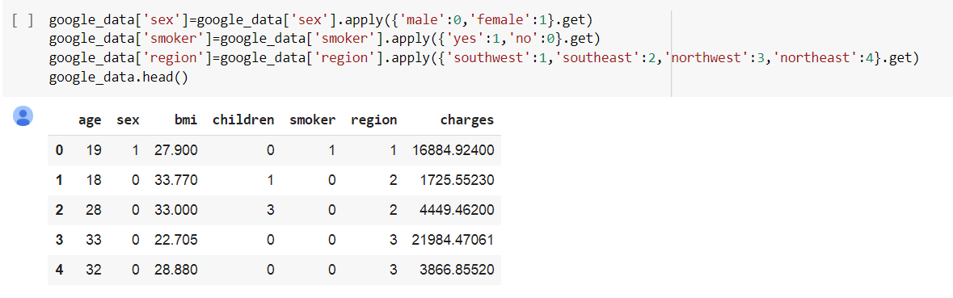
We have quantified all the string data to understand the charges applied accordingly

Slide 17
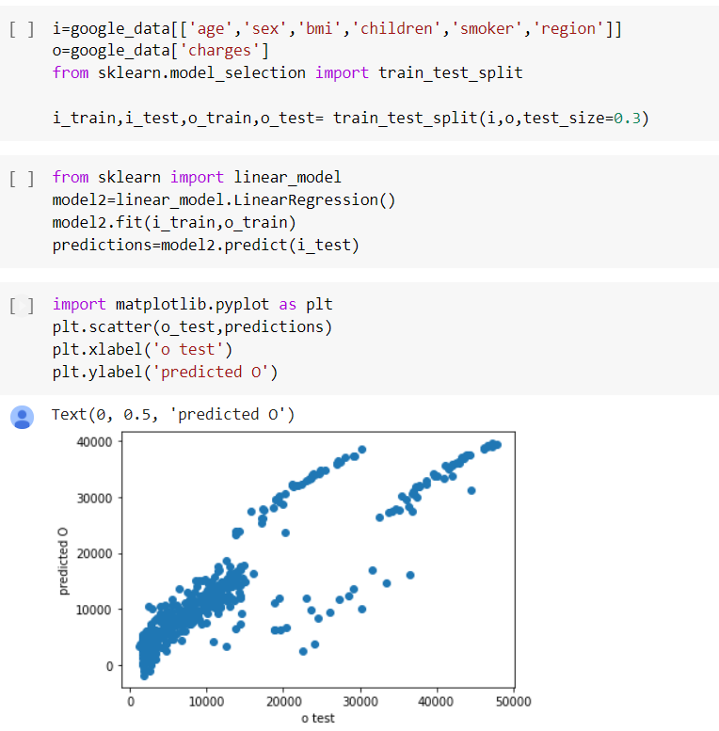
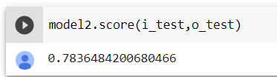
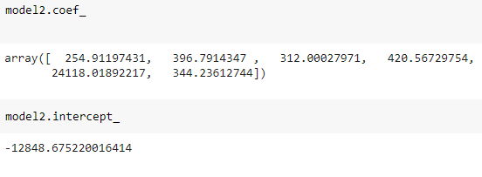
After testing individual parameters, we now tested all the parameters such as age, sex, BMI, number of children, smoking habit & region together to predict charges. From the graph we can conclude that all the factors taken together can predict charges effectively.
The prediction model is 78.36% effective.
Therefore we choose Multivariate Linear Regression

Slide 18

INSIGHT FROM ANALYSIS
Southeast region require better health awareness program.
Males should be encouraged to undergo routine checkups
.
.
Smokers pose more risk hence has to pay more
Encouraging early adoption of insurance to reduce the cost
.
.

Slide 19

FUTURE SCOPE
INSURANCE CHARGES PREDICTION
By using this ML algorithm insurance charges can be predicted for eg:
Data={
'age':45,'sex':1,'bmi':30,'children':2,'smoker':0,'region':3}
Economic Evaluation
Using model Govt can look for economic evaluation of diseases and can take informed steps.

Slide 20
REFRENCES
Dataset link: https://www.kaggle.com/mirichoi0218/insurance
Google colab link: https://colab.research.google.com/drive/1F6106goCdTI2nTWy84mL65MicSiscPR?usp=sharing
Github link:
https://github.com/surabhisingh-gamma/datascience

Slide 21
THANK YOU
Group-7
Surabhi singh(57)
Ankita Pingale(18)
Ria Gandhi(44)
Farheen khan(12)

